Slide 1
IITD’S
Ready Player One
SOMISETTY HARSHA VARDHAN
BODISETTY SAINATH

Slide 2
ABOUT GAME
Enjoy the iitd campus, follow hints to get to the final easter egg. On the way you can enjoy meals of Rajdhani and snacks in Delhi16. You can enjoy pleasant yulu rides. You can earn money by doing tasks. Its a multiplayer game so call a friend to play this game. And here we go… Let’s begin……

Slide 3
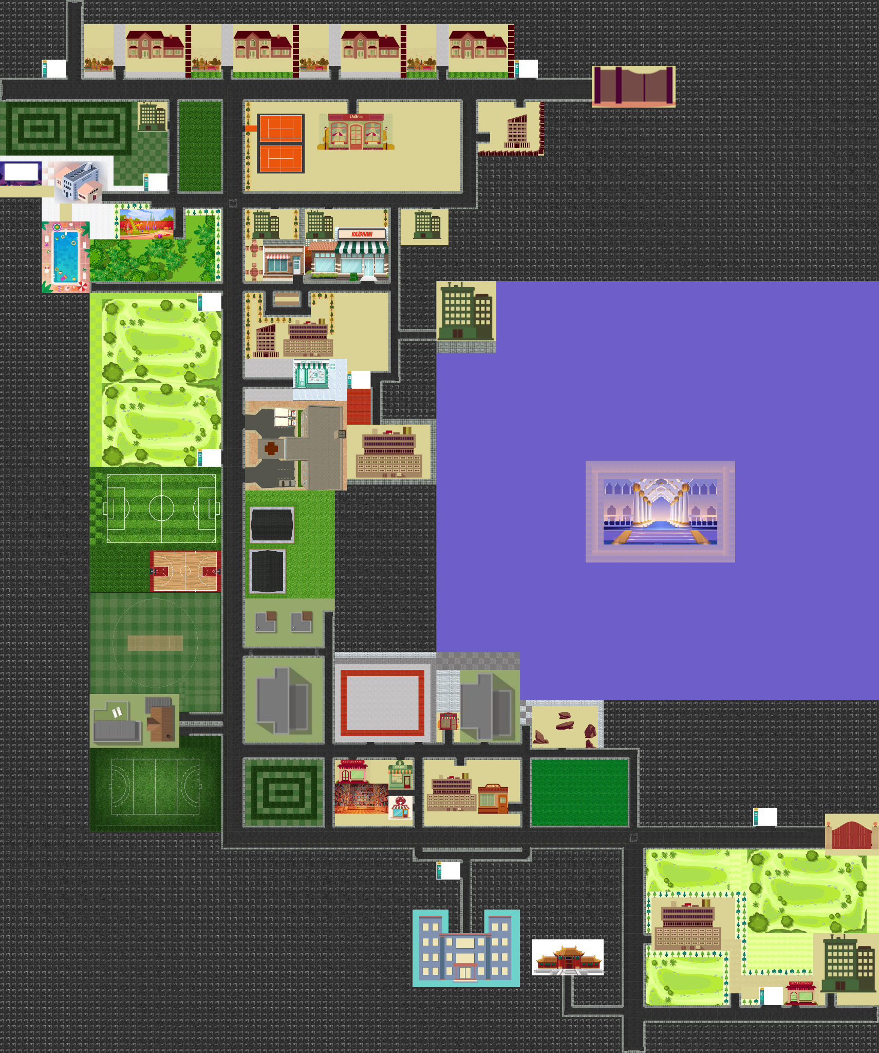

This IS THE
IITD MAP
When you look upclose there we can find beauty of it.

Slide 4
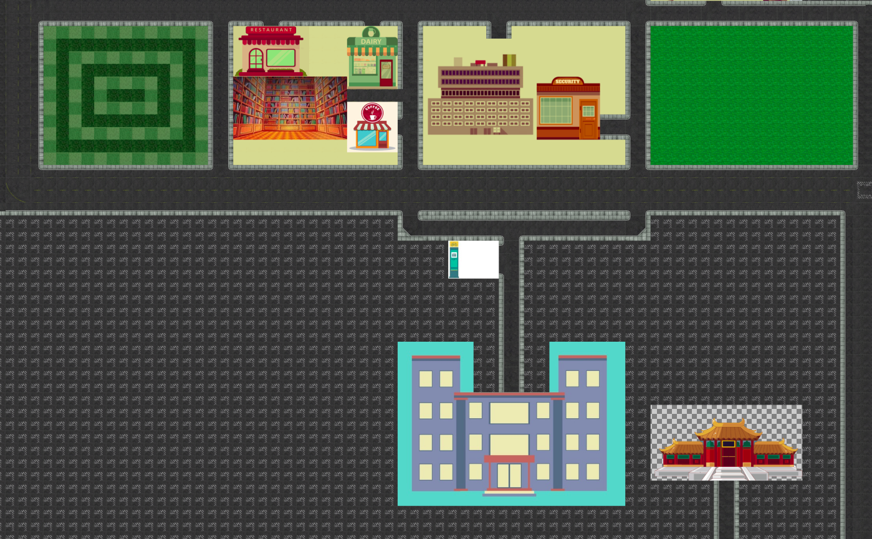
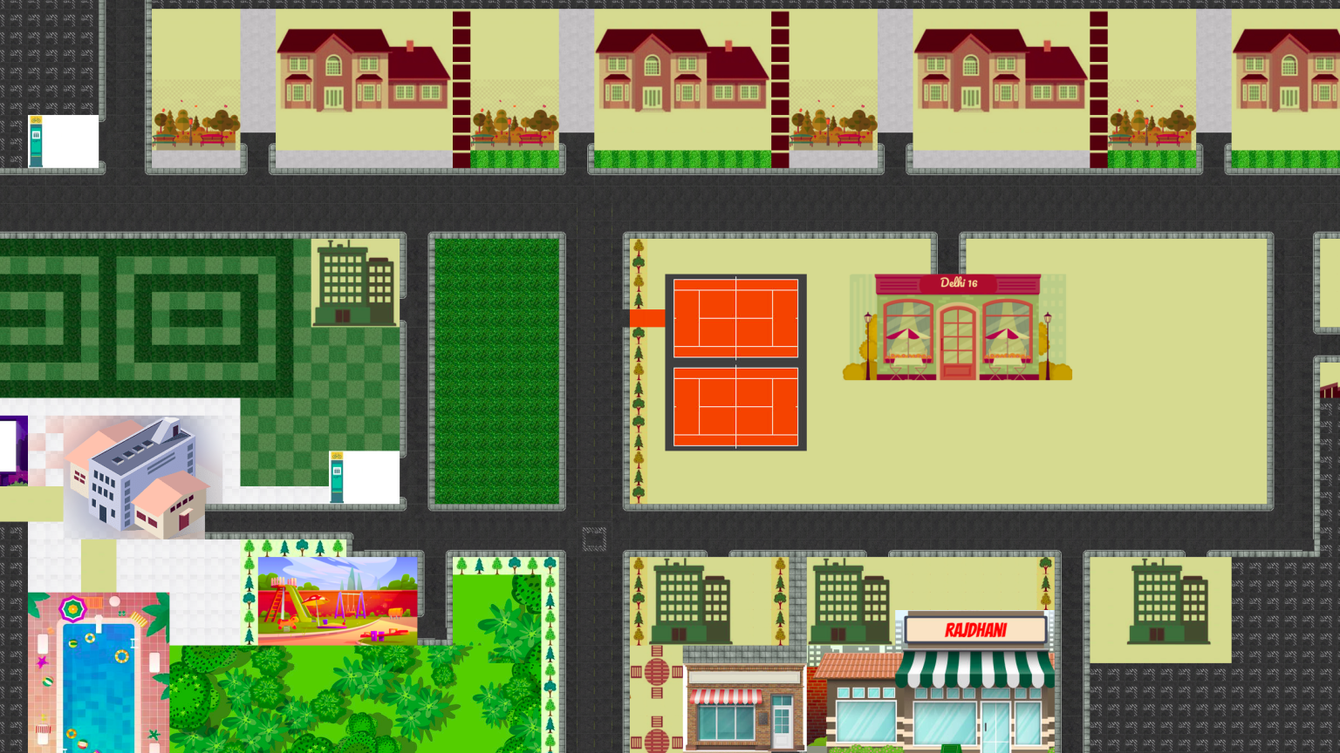
UPCLOSE LOOK

Slide 5
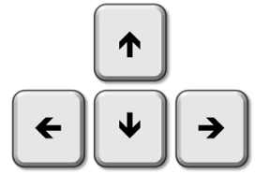
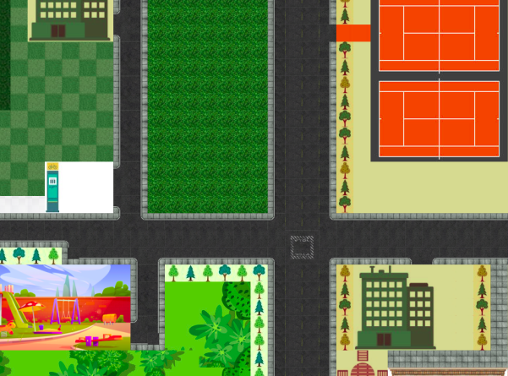
WHEN THE GAME BEGINS THE PLAYER WILL BE AT MAIN GAME.
We use these arrow keys to navigate in any required direction with a given initial speed.

Slide 6
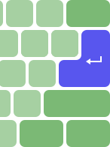



Return key:
This return key is used to collect any item in the game except yulu.
Items like…
etc.

Slide 7





The key “y”:
The key “h”:
The key “r”:
To take yulu near yulu stand
To take Health kit
To Food that You bought.

Slide 8
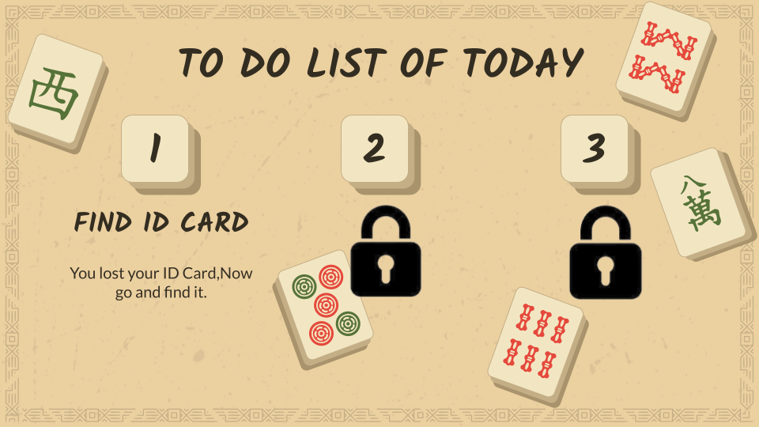
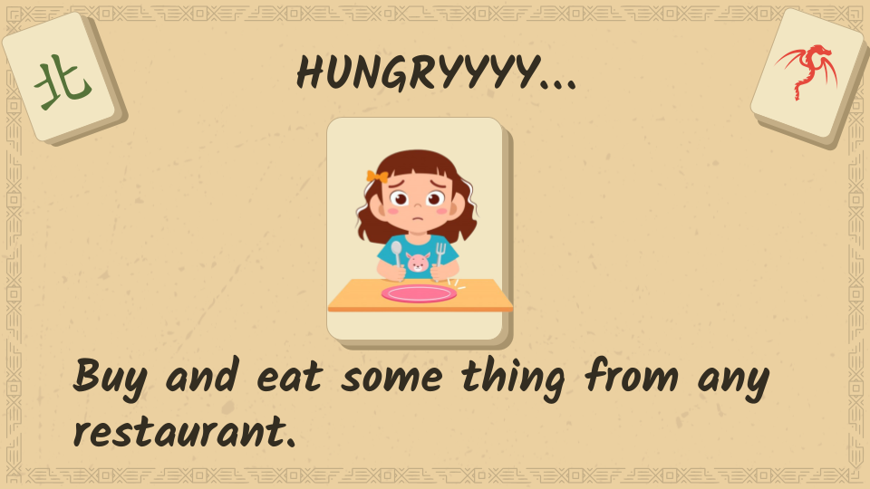
The key “i”:
It gives instructions to the next task when ever it is clicked.
Like.…

Slide 9
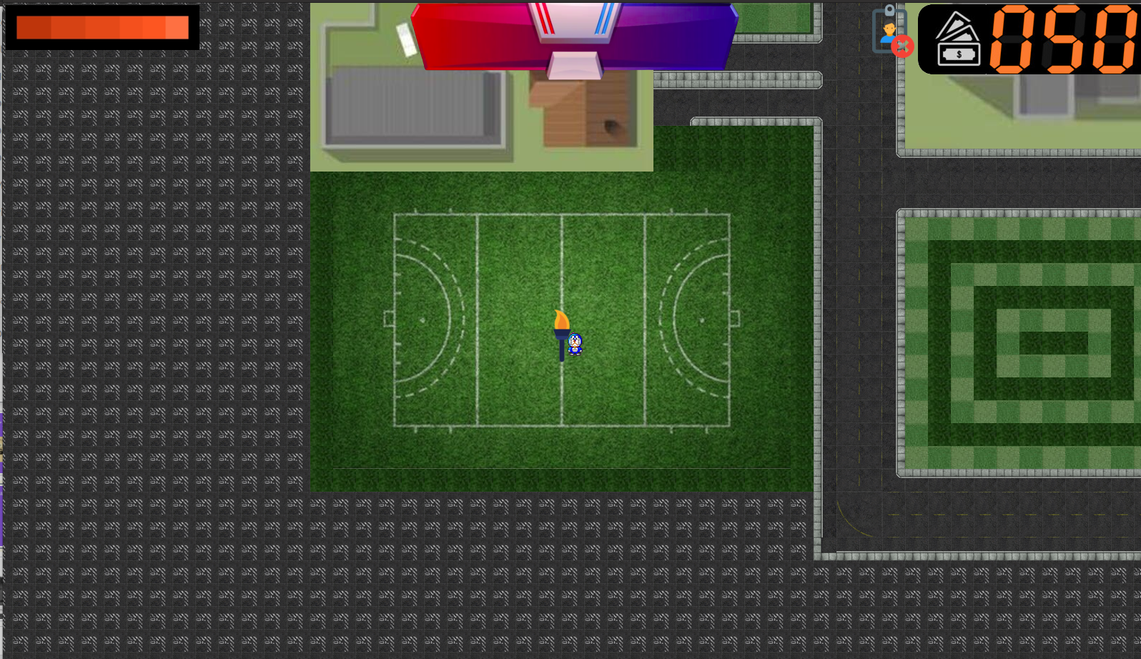
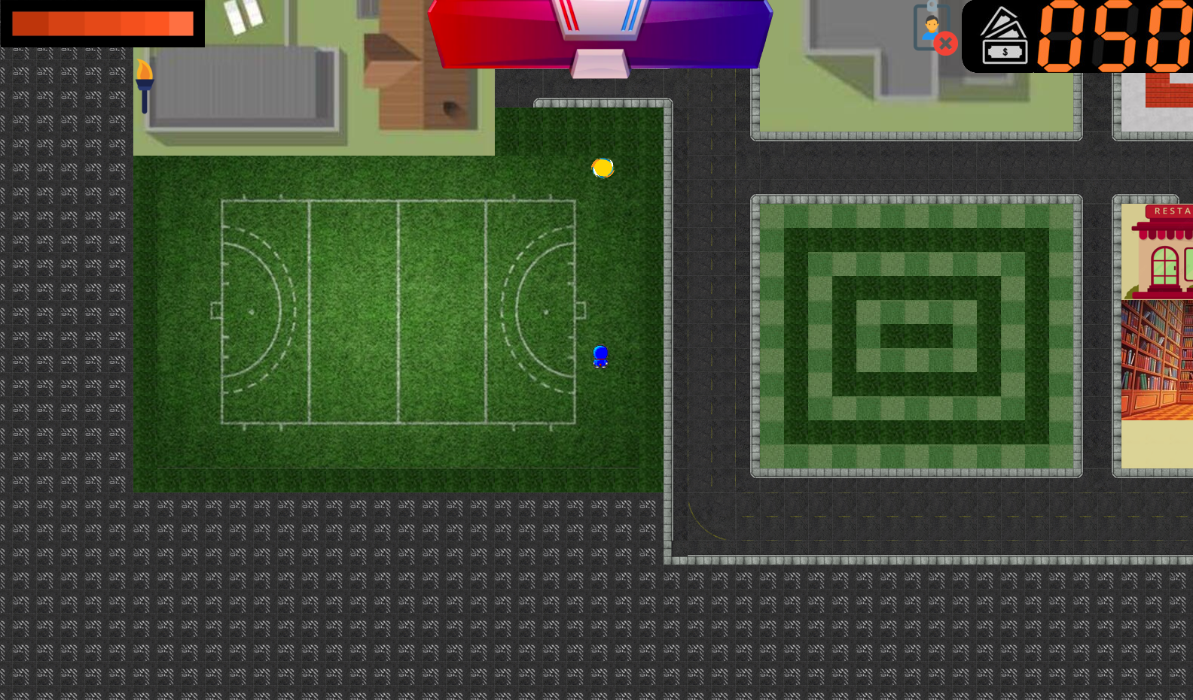
We also have a game to win coins when you complete it.
We will make a complete run to earn 20 points

Slide 10


Finding keys
Reward is 200 and we then go fot key 2
Reward is 200 and we need to find key 3
Reward is 300 and we can now hunt for easter egg

Slide 11
The game is basically to find three keys. And then a portal connecting opens in the building which is located near the himadri. And you will go to a place where you can find the Easter egg once you will win

Slide 12
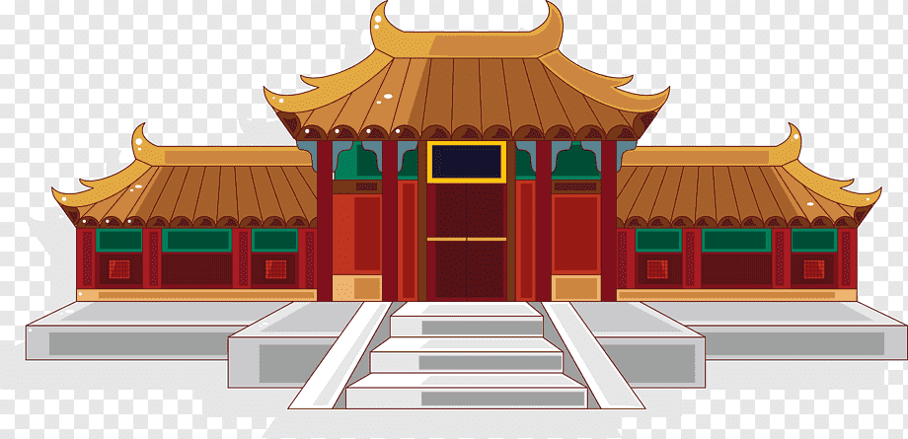
This is the final japanese palace which we need to find and go through it to find easter egg

Slide 13

Then you will find the easter egg

Slide 14
THANK YOU

